Slide 1
Computer Architecture
Reference:
- Mano, “Computer System Architecture”
Computer Architecture Module Content
Central Processing Unit Architecture
  Design Approaches [Stack – Pipelining – Interrupt – Processor Organization
– Registers Organization]
  Instruction Set Architecture [Instruction Format – Addressing modes –
Data Transfer and Manipulation]
  Example architectures (e.g. CISC, RISC)
Timing, Clock Parameters, and Processor Performance
Memory Hierarchy
  Main Memory
  Cache Memory
  Virtual Memory
2

Slide 2
Flags of Signed and Unsigned
numbers
Signed numbers
The relative magnitude of two signed numbers can be determined from the
values of S, V, and Z.
With V = 0, if S = 0 (A > B) and if S = 1 (A < B)
with V = 1 reverse Z =1 (equal)

Slide 3
Unsigned numbers
The relative magnitude of two unsigned numbers can be determined (after a compare instruction) from the values of status bits C and Z.
C = 1 (A > B) C = 0 (A < B)
Z =1 (equal)
Arithmetic Operations (Important Note)
n-bit + n-bit = (n+1) bit n-bit * m-bit = (n+m) bit n-bit / m-bit = (n-m) bit
Unsigned numbers (In HDL languages)
To add/subtract two n-bits unsigned numbers, the result should take n+1 bits.
In HDL languages.
(‘0’ & A) – (‘0’ & B) = F (n+1 bits)
if C =1, it will be added to 1 (2’s comp. of B) = 0 (positive number)
if C =0, it will be added to 1 (2’s comp. of B) = 1 (negative number)

Slide 4
CISC and RISC
Architectures
7
CISC and RISC Architectures
CISC: Complex Instruction Set Computer
RISC: Reduced Instruction Set Computer

Slide 5
Instruction Set Architectures (ISA)
ISA is the abstract structure of a computer seen by an assembly-language programmer.
Early computers had small and simple instruction sets, forced mainly by the need to minimize the hardware used to implement them.
As digital hardware became cheaper with the advent of integrated circuits, computer instructions tended to increase both in number and complexity.
Instruction Set Architectures (ISA)
Many computers have instruction sets with more than 100 and sometimes even more than 200 instructions. These computers also employ a variety of data types and a large number of addressing modes.
A computer with a large number of instructions is classified as a
Complex Instruction Set Computer, abbreviated CISC.
Notes:
The terms CISC (Complex Instruction Set Computer) and RISC (Reduced Instruction Set Computer) represent two differing philosophies in computer architecture, each with its own strengths and weaknesses.
Key Differences between CISC and RISC
Instruction Complexity
CISC:
Offers a large set of complex instructions.
These instructions can perform multiple operations in a single instruction (e.g., load, operate, and store).
Generally leads to fewer lines of assembly code for a program.
RISC:
Utilizes a smaller, simplified instruction set.
Each instruction typically performs a single operation.
May require more lines of code, but often results in more optimized execution.
Data Types and Addressing Modes
CISC:
Supports a rich variety of data types and addressing modes.
Can facilitate complex manipulations in fewer instructions, making it versatile.
RISC:
Focuses on a more limited set of data types and addressing modes.
This simplicity can lead to easier decoding and execution in hardware.
Hardware vs Software Complexity
CISC:
More complex hardware design due to a need to support various types of instructions and addressing modes.
More functionality is built into the hardware level.
RISC:
Tends to simplify hardware complexity by offloading more responsibility to compilers.
This can lead to increased performance as the compiler can optimize instruction usage.
Philosophy Considerations
Complicated or Simple?
CISC architectures often provide complicated instruction sets, which can lead to challenges in understanding and programming.
RISC architectures emphasize simplicity, promoting efficient execution and easier understanding.
Rich or Fundamental Operations?
CISC systems support richer operations with fewer instructions, beneficial for certain types of applications that leverage this complexity.
RISC emphasizes fundamental operations, allowing more straightforward and predictable behavior.
Sophisticated or Basic Addressing Modes?
CISC offers sophisticated addressing modes, which can simplify certain programming tasks.
RISC typically limits addressing modes, which streamlines the instruction execution process, enhancing performance.
Complex in Hardware or Software?
CISC tends to be complex in hardware, making it challenging to design but offering rich features.
RISC focuses on complex software (compilers) for optimizations, resulting in significant performance advantages.
Conclusion
The choice between CISC and RISC ultimately depends on the specific application requirements, the context of use, and the target performance characteristics desired in a computing environment. As technology evolves, the distinction continues to blur, with many modern processors incorporating elements of both philosophies.

Slide 6
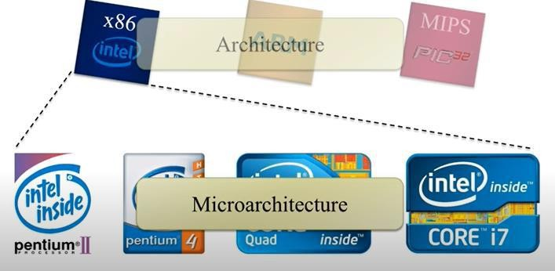
Instruction Set Architectures (ISA)
In the early 1980s, a number of computer designers recommended that computers use fewer instructions with simple constructs so they can be executed much faster within the CPU without having to use memory as often.
This type of computer is classified as a Reduced Instruction Set Computer or RISC.
Instruction Set Architectures (ISA)
ISA is a collection of instructions supported by a common set of processors.
  Intel processors
  ARM – Mobile and embedded systems

Slide 7
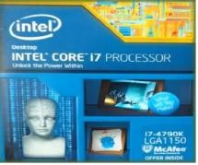
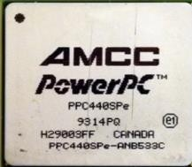
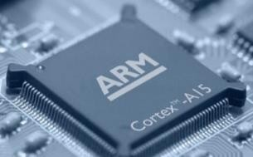
CISC and RISC Architectures
CISC versus RISC philosophy, should the instruction set be
  Complicated or Simple?
  Rich or Fundamental operations?
  Sophisticated or Basic addressing modes?
  Complex in hardware (microarchitecture) or software (compiler)?
CISC and RISC Architectures
CISC: Complex Instruction Set Computer
  Examples: Intel 80x86
RISC: Reduced Instruction Set Computer
  Examples: MIPS, ARM, PowerPC
  Almost all new instruction sets since 1982 followed the RISC philosophy.

Slide 8
CISC vs. RISC
CISC | RISC
Focus on hardware | Focus on software
Code size is small | Code size is large
Uses both hardwired and microprogrammed control unit | Uses only Hardwired control unit
Variable size instructions | Fixed size instructions
Can perform REG to REG or REG to MEM or MEM to MEM operations | Can perform only Register to Register Arithmetic operations
Require less number of registers | Require more number of registers
CISC vs. RISC
CISC
Instruction execution takes more than one clock cycle
RISC
An instruction executed in a single clock cycle
Instructions are larger than the size of one word
An instruction fit in one word
Complex and more addressing modes
Simple and limited addressing modes
Basic-Computer CISC or RISC ??? And why ???

Slide 9
Complex Instruction Set Computer (CISC)
Major characteristics of CISC architecture are:
  A large number of instructions typically from 100 to 250 instructions
  Some instructions that perform specialized tasks and are used infrequently.
  A large variety of addressing modes typically from 5 to 20 different modes
  Variable-length instruction formats
  Instructions that manipulate operands in memory
Reduced Instruction Set Computer (RISC)
Major characteristics of RISC processor are:
  Relatively few instructions
  Relatively few addressing modes
  Memory access is limited to load and store instructions
  All operations are done within the registers of the CPU
  Fixed-length, easily decoded instruction format
  Single-cycle instruction execution.
  Hardwired rather than microprogrammed control
[A load or store instruction may require two clock cycles because access to memory takes more time than register operations.]
Notes:
The Basic Computer architecture is primarily classified as CISC (Complex Instruction Set Computer) due to several of its characteristics. Here's a detailed explanation:
Characteristics of Basic Computer Aligning with CISC
Large Instruction Set:
CISC architectures typically feature a larger number of instructions (ranging from 100 to 250 or more).
The Basic Computer includes a wide variety of instructions that allow users to perform complex operations without extensive programming.
Specialized Instructions:
CISC often has specialized instructions that may not be commonly used, but are provided to perform specific, complex functions efficiently.
Basic Computer accommodates specialized tasks, making it versatile for different programming needs.
Variety of Addressing Modes:
CISC architectures support numerous addressing modes (typically 5 to 20), which allows for more flexible data access.
The Basic Computer supports various addressing methods, contributing to its flexibility in data manipulation.
Variable-Length Instruction Formats:
Instructions in CISC architectures can vary in length, which optimizes memory usage and allows for a more complex operation to be encoded in a single instruction.
The Basic Computer embraces this concept through its instructions, allowing for different operations to be encoded variably.
Memory Operand Manipulation:
CISC architectures enable instructions that can manipulate operands directly in memory, reducing the need for multiple operations to accomplish a single task.
The Basic Computer exemplifies this by allowing instructions to directly operate on memory operands.
Conclusion
Given these characteristics, the Basic Computer architecture aligns closely with the CISC philosophy. Its design maximizes the complexity and capability of operations at the cost of increased hardware complexity. This structure was advantageous in the early days of computing, where memory and performance enhancements were prioritized through richer instruction sets and addressing modes.
Major Characteristics of RISC Processors
RISC (Reduced Instruction Set Computer) architecture focuses on efficiency and performance through simplicity. Here are the key characteristics:
Relatively Few Instructions
RISC processors have a small set of instructions, typically fewer than their CISC counterparts. This simplicity allows for more efficient instruction decoding and execution.
Relatively Few Addressing Modes
A limited number of addressing modes are available, which simplifies the hardware design and speeds up instruction processing.
Memory Access Limited to Load and Store Instructions
RISC architectures restrict memory access operations to specific load and store instructions, limiting direct memory operations to ensure that most data manipulation takes place within the CPU registers.
All Operations Within Registers
Operations are primarily performed within registers, eliminating the need for multiple memory accesses during computation.
Fixed-Length, Easily Decoded Instruction Format
Instructions are typically of uniform length, facilitating easy and rapid decoding, which enhances execution efficiency.
Single-Cycle Instruction Execution
Many RISC designs allow for single-cycle execution of instructions, which contributes to high performance. However, it’s worth noting that load and store operations may require an additional clock cycle due to memory access times.
Hardwired Rather than Microprogrammed Control
Control logic is often hardwired instead of being microprogrammed. This choice simplifies the control unit and can lead to faster instruction execution.
Note on Memory Access
Memory Access Timing:
Although most instructions can be executed in a single cycle, load and store instructions may require two clock cycles since accessing memory is inherently slower than operations within the CPU registers. This distinction is crucial for optimizing performance and understanding potential bottlenecks in RISC architectures.
These characteristics collectively allow RISC processors to achieve high performance, making them suitable for a wide range of applications, particularly in environments where efficiency and speed are paramount.

Slide 10
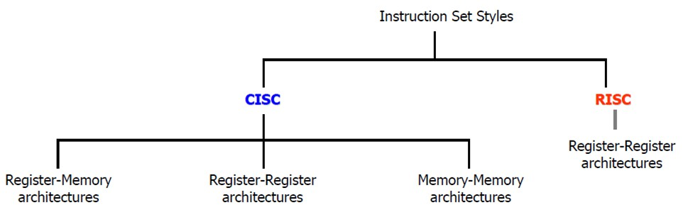
Reduced Instruction Set Computer (RISC)
Other characteristics attributed to RISC architecture are:
  A relatively large number of registers in the processor unit
  Use of overlapped register windows to speed-up procedure call and return
  Efficient instruction pipeline
  Compiler support for efficient translation of high-level language programs into machine language programs
Instruction Set Styles

Slide 11
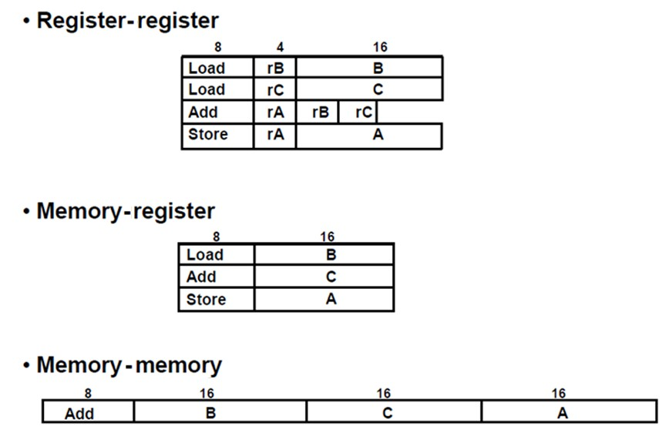



Instruction Set Styles for Arithmetic Operations
Instruction Set Styles

Slide 12

Instruction Set Styles
Overlapped Register Windows
Overlapped register windows are used by some RISC processors to
  Provide the passing of parameters
  Avoid the need for saving and restoring register values.
Each procedure call:
  Allocates and activates a new window consisting of a set of registers from the register file for use by the new procedure.
  Increments a pointer, while the return statement decrements the pointer and causes
the activation of the previous window.
Windows for adjacent procedures have overlapping registers that are shared to provide the passing of parameters and results.

Slide 13
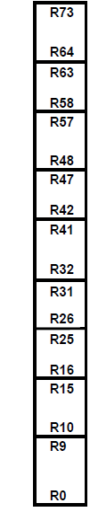
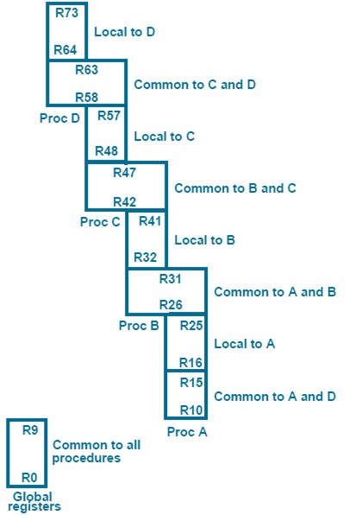
Overlapped Register Windows
In general, the organization of register windows has the following relationships:
  number of global registers = G
  number of local registers in each window = L
  number of registers common to two windows = C
  number of windows = W
The number of registers available for each window (procedure) is calculated as follows:
Window size = G + L + 2C
The total number of registers needed in the processor is
Register file = G + (L + C) W
Overlapped Register
Windows Example
Register file has 74 register
Allocation:
  10 global
  10 local to each window
  6 shared between adjacent procedures
Each procedure has a total of 32 registers while it is active. This includes:
  10 global registers,
  10 local registers,
  6 low overlapping registers,
  and 6 high overlapping registers.

Slide 14
Overlapped Register Windows
In the example: G = 10, L = 10, C = 6, W = 4.
  window size is 10 + 12 + 10 = 32 registers
  register file = (10 + 6) x 4 + 10 = 74 registers.
Berkeley RISC I Processor
28

Slide 15
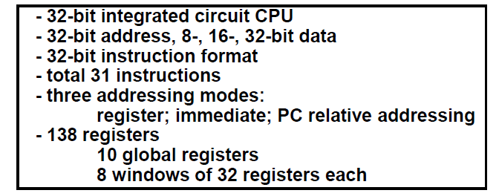
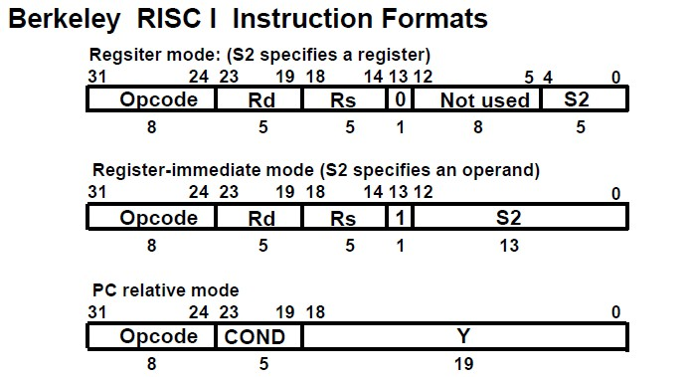
Berkeley RISC I
Berkeley RISC I

Slide 16
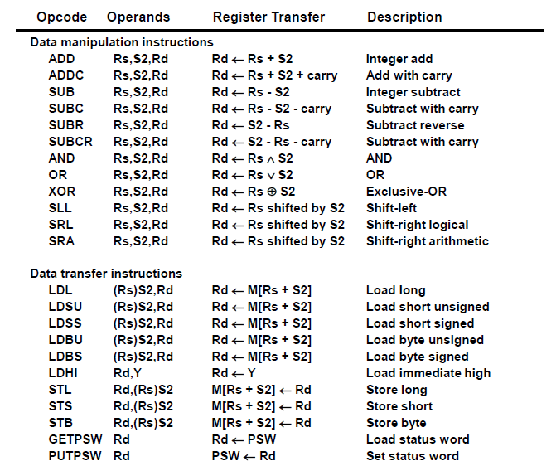
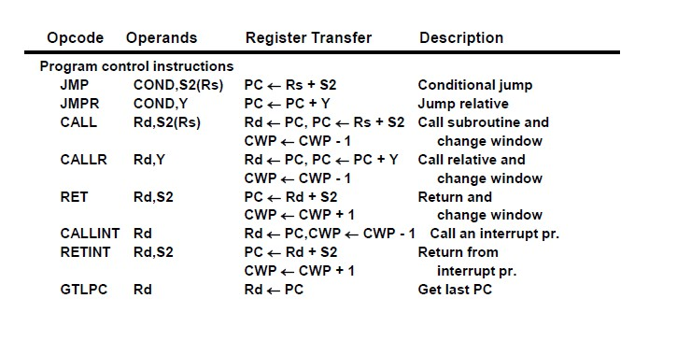
Berkeley RISC I
Berkeley RISC I

Slide 17
Berkeley RISC I
8 bits in the operation code specify an operation
The instruction has a three-address format, but the second source may be either a register or an immediate operand.
The register-to-register instructions,
The 5-bit Rd field selects one of the 32 registers as a destination for the result of the operation.
The operation is performed with the data specified in fields Rs and S2.
If bit 13 of the instruction is 0, the low-order 5 bits of S2 specify another source register.
If bit l3 of the instruction is 1, S2 specifies a sign-extended l3-bit constant.
Berkeley RISC I
The memory access instructions
  Use Rs to specify a 32-bit address in a register and S2 to specify an offset.
Register R0 contains all 0’s, so it can be used in any field to specify a zero quantity.
# for immediate operand
The program control instructions:
  Combines the last three fields to form a 19-bit relative address Y
  It is used primarily with the jump and call instructions.
  The COND field replaces the Rd field for jump instructions and is used to specify one of 16 possible branch conditions.

Slide 18
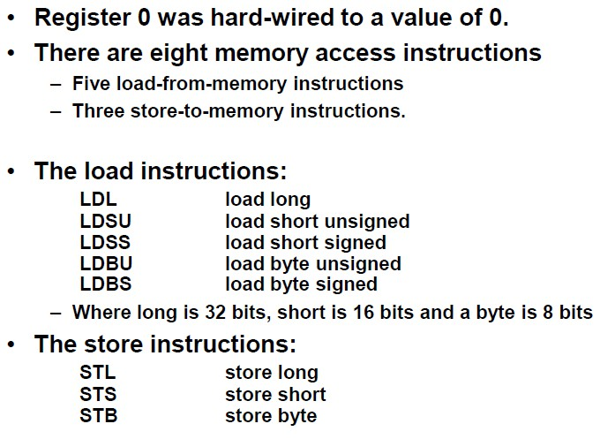
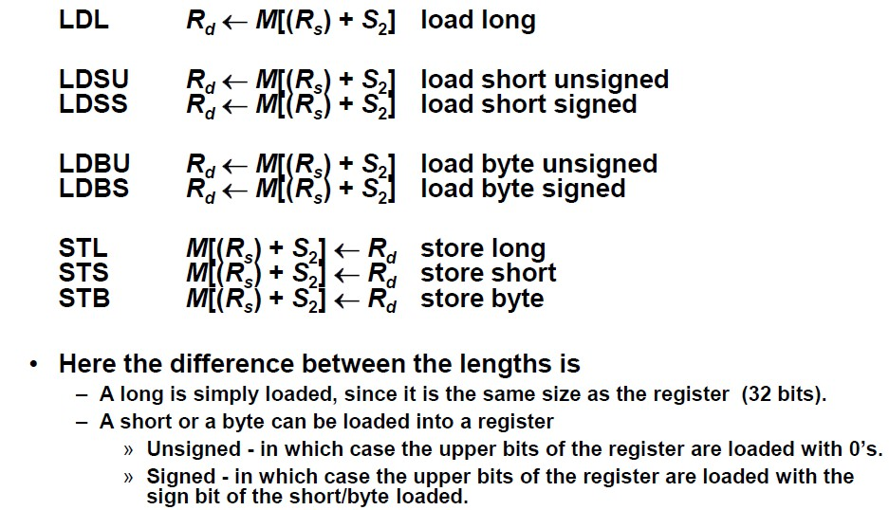
Berkeley RISC I
Berkeley RISC I

Slide 19
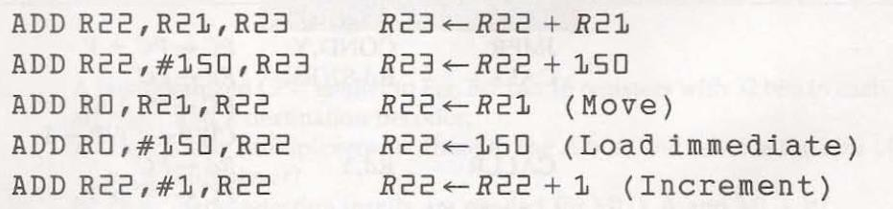
Berkeley RISC I
ADD instruction and how it can be used to perform a variety of operations
Berkeley RISC I
R1 ← M[B]
Direct address mode
Indirect address mode
Register mode
Register Indirect mode
Autoincrement or Autodecrement mode
PC Relative Addressing mode
Indexed Addressing Mode

Slide 20
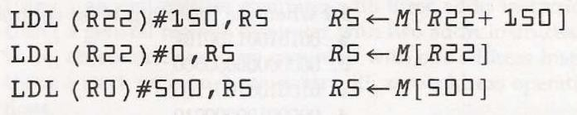
Berkeley RISC I
Examples of load long instructions with different addressing modes
  The effective address in the first instruction is evaluated from the contents of
register R22 plus a displacement of 150.
  The second instruction uses a 0 displacement, which reduces it to a register indirect mode.
  The third instruction uses all 0' s from register R0 to produce a direct address type of instruction.

